Slide 1
Stepping into Web Arena
Sajid Rabbani
Senior Software Engineer
Nascenia

Slide 2
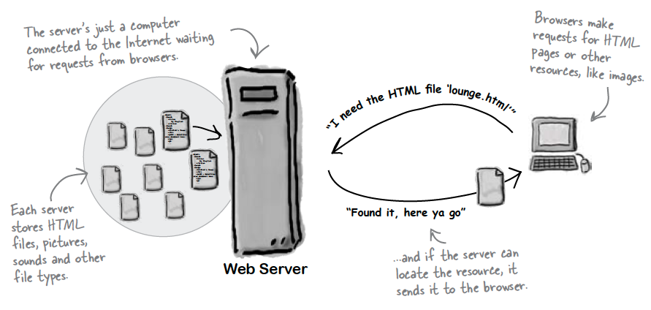
What does Web Server do?

Slide 3
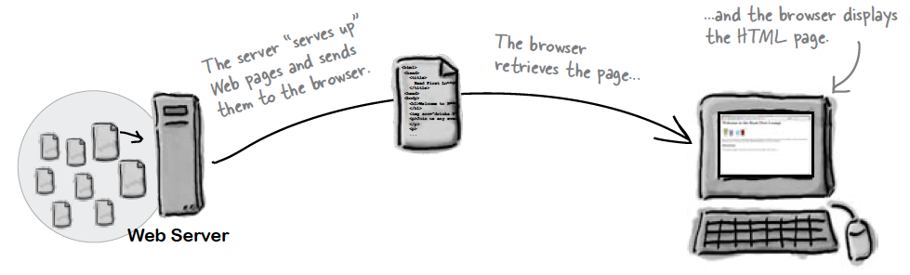
What does Web Browser do?

Slide 4
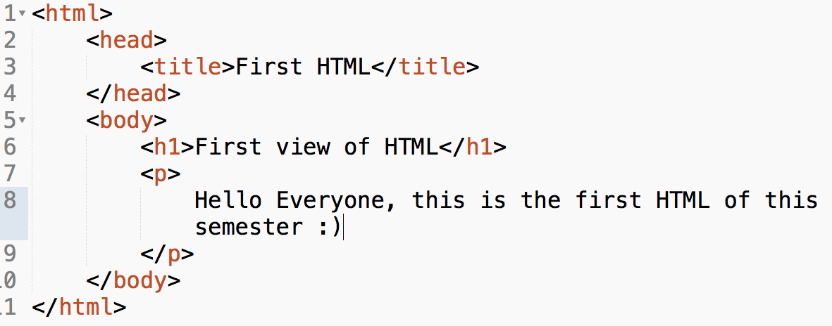
Checkout what is in HTML?

Slide 5
What is HTML?
HTML stands for Hyper Text Markup Language
Tell the browser about content & structure
.html or .htm file extension will make html file

Slide 6
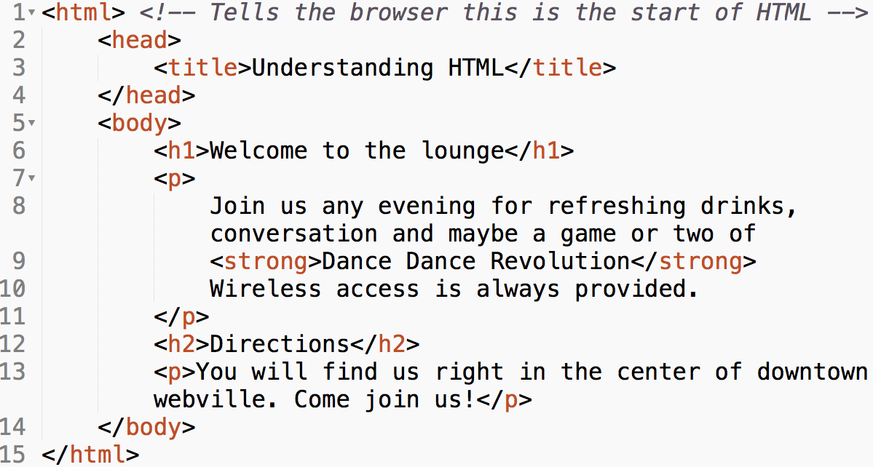
Identify HTML Tags

Slide 7
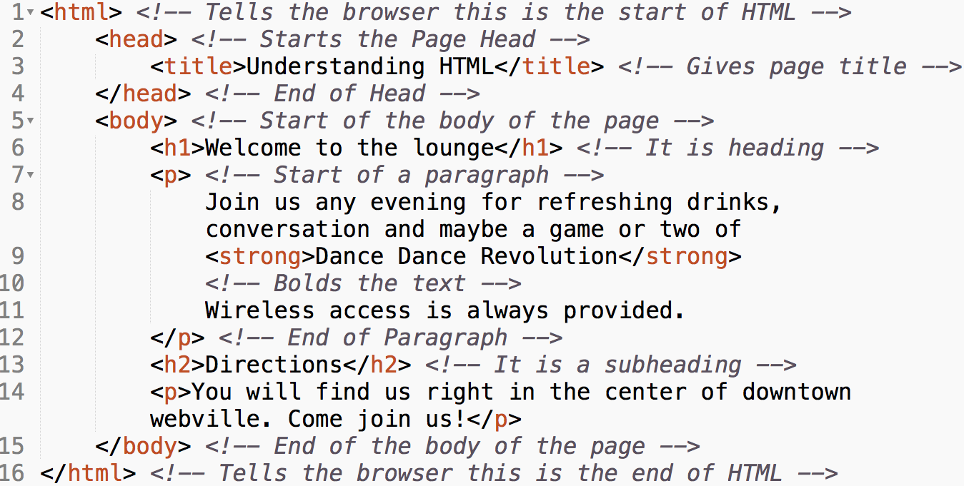
Identify HTML Tags

Slide 8
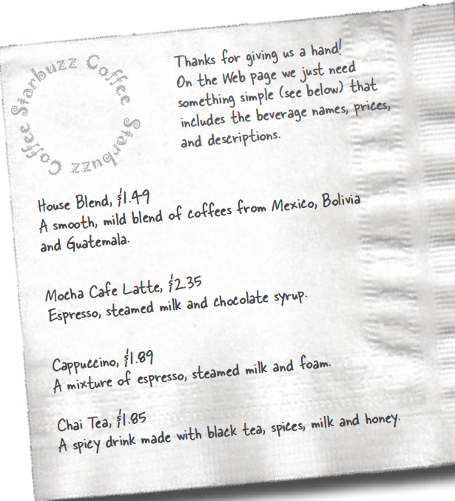
Make your hands dirty!

Slide 9
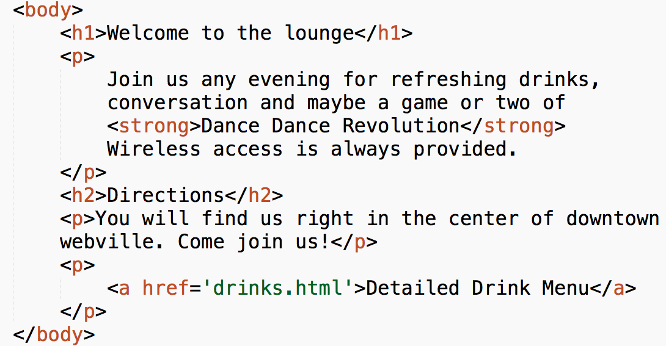
Linking Web Pages

Slide 10
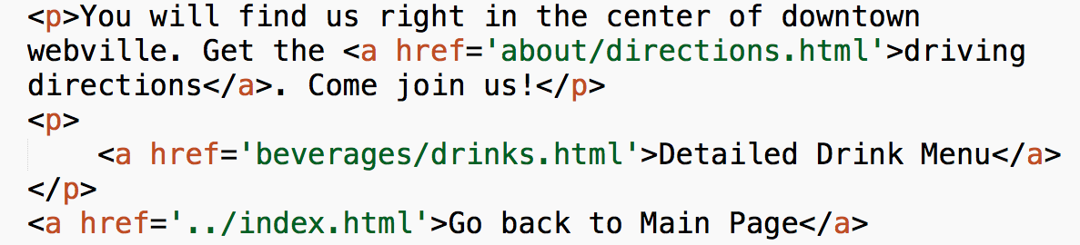
Linking Web Pages

Slide 11
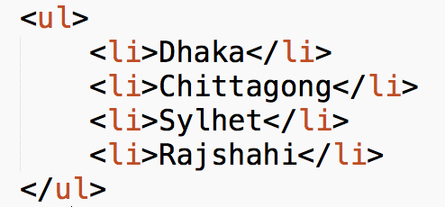
Listing

Slide 12
Listing Tags
ul -> unordered list
ol -> ordered list
li -> list item

Slide 13
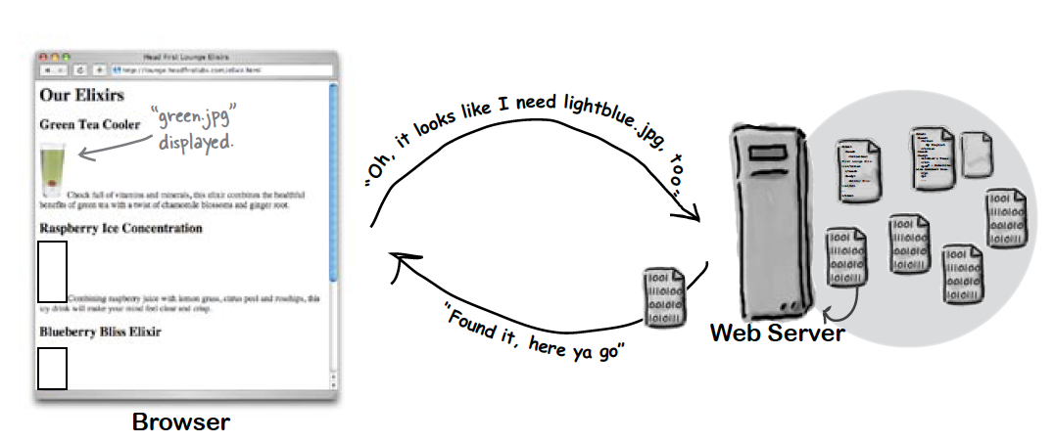
Meeting the Media

Slide 14
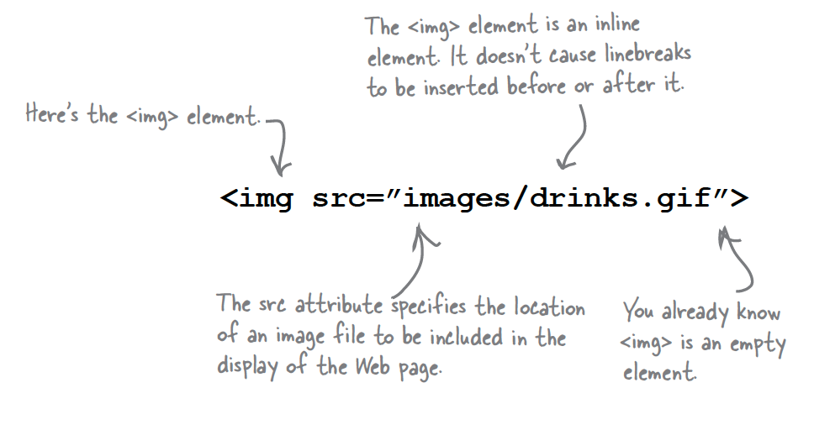
Image Tag

Slide 15
Block vs. Inline
Block | Inline
Stands on its own | Goes with the flow
<h1>, <h2>, <p>, <div>, <table> | <a>,<strong>, <img>, <span>

Slide 16
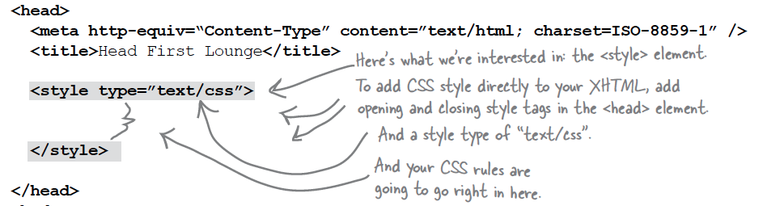
Exploring CSS

Slide 17
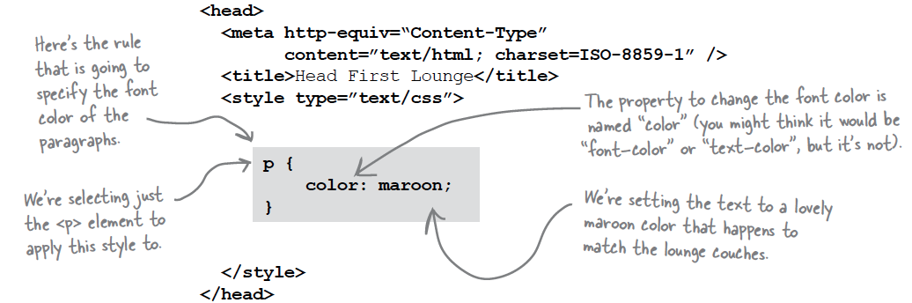
Exploring CSS

Slide 18
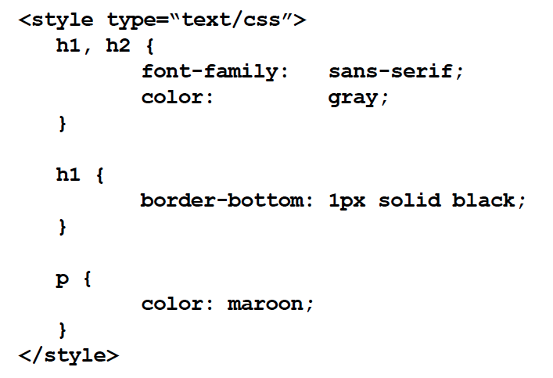
Try yourself!

Slide 19
Important CSS Property
Color - used to set font color of text elements
Font-weight - controls the weight of the text
Left - how to position left side of the element
Line-height - sets space between lines
Background-color – sets the background color
Border – puts a border around the element
Font-size – makes text bigger or smaller

Slide 20
Important CSS Property
Margin – give space between element & its content.
Background-image – put image behind
Text-align – used to align your text
Font-style – used for italic or oblique text
List-style – used to change the appearance of of list items

Slide 21
